Slide 1
JavaScript ES6
21 May 18 | Start
23 May 18
Appendix
Online

Slide 2
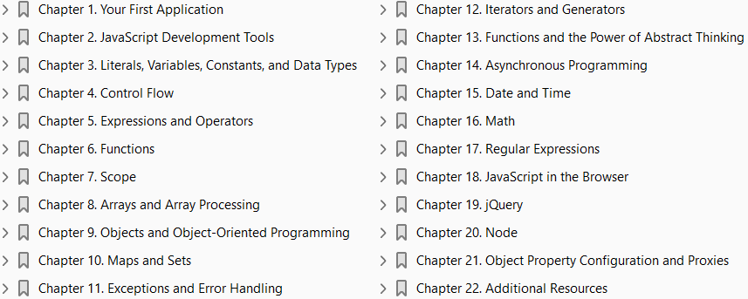
JavaScript ES6
Ch | Date
1 | 23 May 18
2
3
4
5
6
7
8
Learning JavaScript ES6 03 2016

Slide 3
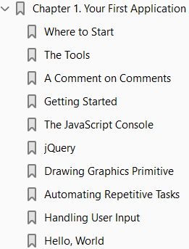
1
Your First Application

Slide 4
Intro
Often, the best way to learn is to do: so we’re going to start off by creating a simple application.
The point of this chapter is not to explain everything that’s going on: there’s a lot that’s going to be unfamiliar and confusing, and my advice to you is to relax and not get caught up in trying to understand everything right now.
The point of this chapter is to get you excited.
Just enjoy the ride; by the time you finish this book, everything in this chapter will make perfect sense to you.
In this chapter, we will balance the tradition that Brian Kernighan started 44 years ago with the sophistication available to programmers today.
We will see “hello world” on our screen, but it will be a far cry from the blocky words etched in glowing phosphor you would have enjoyed in 1972.

Slide 5
History of “Hello World”
Historically, programming books have started out with an example called “Hello, World” that simply prints the phrase “hello world” to your terminal.
It may interest you to know that this tradition was started in 1972 by Brian Kernighan, a computer scientist working at Bell Labs.
It was first seen in print in 1978 in The C Programming Language, by Brian Kernighan and Dennis Ritchie.
To this day, The C Programming Language is widely considered to be one of the best and most influential programming language books ever written, and I have taken much inspiration from that work in writing this book.
While “Hello, World” may seem dated to an increasingly sophisticated generation of programming students, the implicit meaning behind that simple phrase is as potent today as it was in 1978: they are the first words uttered by something that you have breathed life into.
It is proof that you are Prometheus, stealing fire from the gods;
a rabbi scratching the true name of God into a clay golem
Doctor Frankenstein breathing life into his creation
It is this sense of creation, of genesis, that first drew me to programming. Perhaps one day, some programmer—maybe you—will give life to the first artificially sentient being. And perhaps its first words will be “hello world.”

Slide 6
Tip
If you don’t have much programming experience, one of the things that is going to cause you a lot of frustration at first is how literal computers are.
Our human minds can deal with confusing input very easily, but computers are terrible at this.
If I make a grammatical error, it may change your opinion about my writing ability, but you will probably still understand me.
JavaScript—like all programming languages—has no such facility to deal with confusing input.
Capitalization, spelling, and the order of words and punctuation are crucial.
If you’re experiencing problems, make sure you’ve copied everything correctly: you haven’t substituted semicolons for colons or commas for periods, you haven’t mixed single quotation and double quotation marks, and you’ve capitalized all of your code correctly.
Once you’ve had some experience, you’ll learn where you can “do things your way,” and where you have to be perfectly literal, but for now, you will experience less frustration by entering the examples exactly as they’re written.

Slide 7
Where to Start
In this book, we will cover the use of JavaScript in all its current incarnations (serverside, scripting, desktop, browser-based, and more), but for historical and practical reasons, we’re going to start with a browser-based program.
One of the reasons we’re starting with a browser-based example is that it gives us easy access to graphics libraries.
Humans are inherently visual creatures, and being able to relate programming concepts to visual elements is a powerful learning tool.
We will spend a lot of time in this book staring at lines of text, but let’s start out with something a little more visually interesting.
I’ve also chosen this example because it organically introduces some very important concepts, such as event-driven programming, which will give you a leg up on later chapters.

Slide 8
The Tools
Just as a carpenter would have trouble building a desk without a saw, we can’t write software without some tools.
Fortunately, the tools we need in this chapter are minimal:
a browser
a text editor

Slide 9
Browser
I am happy to report that, as I write this, there is not one browser on the market that is not suited to the task at hand.
Even Internet Explorer—which has long been a thorn in the side of programmers—has cleaned up its act, and is now on par with
Chrome
Firefox
Safari
Opera
That said, my browser of choice is Firefox, and in this text, I will discuss Firefox features that will help you in your programming journey.
Other browsers also have these features, but I will describe them as they are implemented in Firefox, so the path of least resistance while you go through this book will be to use Firefox.

Slide 10
Text Editor
You will need a text editor to actually write your code.
The choice of text editors can be a very contentious—almost religious—debate.
Broadly speaking, text editors can be categorized as
text-mode editors
windowed editors.
The two most popular text-mode editors are
vi/vim
Emacs
One big advantage to text-mode editors is that, in addition to using them on your computer, you can use them over SSH—meaning you can remotely connect to a computer and edit your files in a familiar editor.
Windowed editors can feel more modern, and add some helpful (and more familiar) user interface elements.
At the end of the day, however, you are editing text only, so a windowed editor doesn’t offer an inherent advantage over a text-mode editor.
Popular windowed editors are
Atom

Slide 11
Text Editor |
Sublime Text
Coda
Visual Studio
Notepad++
TextPad
Xcode
If you are already familiar with one of these editors, there is probably no reason to switch.
If you are using Notepad on Windows, however, I highly recommend upgrading to a more sophisticated editor (Notepad++ is an easy and free choice for Windows users).

Slide 12
Features of Text Editors
Describing all the features of your editor is beyond the scope of this book, but there are a few features that you will want to learn how to use:
Syntax highlighting
Bracket matching
Code folding
Autocompletion

Slide 13
Syntax highlighting
Syntax highlighting uses color to distinguish syntactic elements in your program.
For example, literals might be one color and variables another (you will learn what these terms mean soon!).
This feature can make it easier to spot problems in your code.
Most modern text editors will have syntax highlighting enabled by default; if your code isn’t multicolored, consult your editor documentation to learn how to enable it.

Slide 14
Bracket matching
Most programming languages make heavy use of
Parentheses
curly braces
square brackets (collectively referred to as “brackets”)
Sometimes, the contents of these brackets span many lines, or even more than one screen, and you’ll have brackets within brackets, often of different types.
It’s critical that brackets match up, or “balance”; if they don’t, your program won’t work correctly.
Bracket matching provides visual cues about where brackets begin and end, and can help you spot problems with mismatched brackets.
Bracket matching is handled differently in different editors, ranging from a very subtle cue to a very obvious one.
Unmatched brackets are a common source of frustration for beginners, so I strongly recommend that you learn how to use your editor’s bracket-matching feature.

Slide 15
Code folding
Somewhat related to bracket matching is code folding.
Code folding refers to the ability to temporarily hide code that’s not relevant to what you’re doing at the moment, allowing you to focus.
The term comes from the idea of folding a piece of paper over on itself to hide unimportant details.
Like bracket matching, code folding is handled differently by different editors.

Slide 16
Autocompletion
Autocompletion (also called word completion or IntelliSense ) is a convenience feature that attempts to guess what you are typing before you finish typing it.
It has two purposes.
The first is to save typing time.
Instead of typing, for example, encodeURIComponent, you can simply type enc, and then select encodeURIComponent from a list.
The second purpose is called discoverability.
For example, if you type enc because you want to use encodeURIComponent, you’ll find (or “dis‐ cover”) that there’s also a function called encodeURI.
Depending on the editor, you may even see some documentation to distinguish the two choices.
Autocompletion is more difficult to implement in JavaScript than it is in many other languages because it’s a loosely typed language, and because of its scoping rules (which you will learn about later).
If autocompletion is an important feature to you, you may have to shop around to find an editor that meets your needs: this is an area in which some editors definitely stand out from the pack.
Other editors (vim, for example) offer very powerful autocompletion, but not without some extra configuration.

Slide 17
A Comment on Comments
JavaScript—like most programming languages—has a syntax for making comments in code.
Comments are completely ignored by JavaScript; they are meant for you or your fellow programmers.
They allow you to add natural language explanations of what’s going on when it’s not clear.
In this book, we’ll be liberally using comments in code samples to explain what’s happening.
In JavaScript, there are two kinds of comments:
inline comments
block comments
An inline comment starts with two forward slashes (//) and extends to the end of the line.
A block comment starts with a forward slash and an asterisk (/*) and ends with an asterisk and a forward slash (*/), and can span multiple lines.
Here’s an example that illustrates both types of comments: Listing 1-1.
Cascading Style Sheets (CSS), which we’ll see shortly, also use JavaScript syntax for block comments (inline comments are not supported in CSS).
HTML (like CSS) doesn’t have inline comments, and its block comments are different than JavaScript.
They are surrounded by the unwieldy <!-- and -->: Listing 1-2.

Slide 18
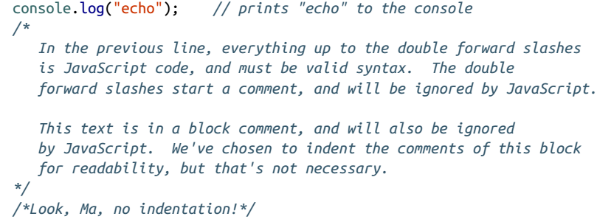
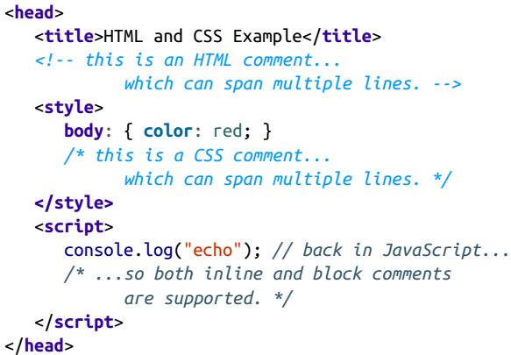
Listing 1-1 || 1-2

Slide 19
Getting Started
We’re going to start by creating three files:
an HTML file
a CSS file
a JavaScript source file
We could do everything in the HTML file (JavaScript and CSS can be embedded in HTML), but there are certain advantages to keeping them separate.
If you’re new to programming, I strongly recommend that you follow along with these instructions step by step: we’re going to take a very exploratory, incremental approach in this chapter, which will facilitate your learning process.
It may seem like we’re doing a lot of work to accomplish something fairly simple, and there’s some truth in that.
I certainly could have crafted an example that does the same thing with many fewer steps, but by doing so, I would be teaching you bad habits.
The extra steps you’ll see here are ones you’ll see over and over again, and while it may seem overcomplicated now, you can at least reassure yourself that you’re learning to do things the right way.

Slide 20
Getting Started |
One last important note about this chapter.
This is the lone chapter in the book in which the code samples will be written in ES5 syntax, not ES6 (Harmony).
This is to ensure that the code samples will run, even if you aren’t using a browser that has implemented ES6.
In the following chapters, we will talk about how to write code in ES6 and “transcompile” it so that it will run on legacy browsers.
After we cover that ground, the rest of the book will use ES6 syntax.
The code samples in this chapter are simple enough that using ES5 doesn’t represent a significant handicap.

Slide 21
NOTE
For this exercise, you’ll want to make sure the files you create are in the same directory or folder.
I recommend that you create a new directory or folder for this example so it doesn’t get lost among your other files.

Slide 22

Example
Let’s start with the JavaScript file. Using a text editor, create a file called main.js.
For now, let’s just put a single line in this file:
Then create the CSS file, main.css.
We don’t actually have anything to put in here yet, so we’ll just include a comment so we don’t have an empty file:
Then create a file called index.html: Listing 1-3.
While this book isn’t about HTML or web application development, many of you are learning JavaScript for that purpose, so we will point out some aspects of HTML as they relate to JavaScript development.

Slide 23
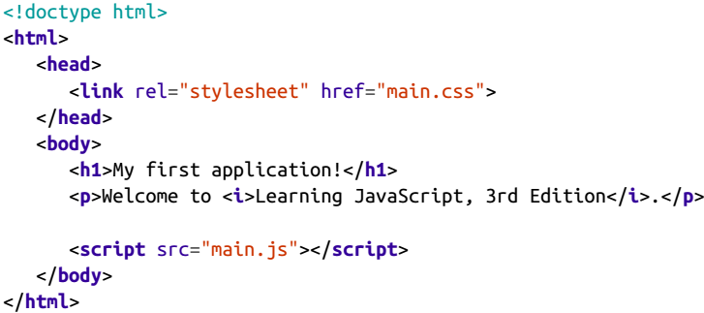
Listing 1-3

Slide 24
HTML Document
An HTML document consists of two main parts:
the head
the body
The head contains information that is not directly displayed in your browser (though it can affect what’s displayed in your browser).
The body contains the contents of your page that will be rendered in your browser.
It’s important to understand that elements in the head will never be shown in the browser, whereas elements in the body usually are (certain types of elements, like <script>, won’t be visible, and CSS styles can also hide body elements).
In the head, we have the line <link rel="stylesheet" href="main.css">; this is what links the currently empty CSS file into your document.
Then, at the end of the body, we have the line <script src="main.js"></script>, which is what links the JavaScript file into your document.
It may seem odd to you that one goes in the head and the other goes at the end of the body.
While we could have put the <script> tag in the head, there are performance and complexity reasons for putting it at the end of the body.

Slide 25
HTML Document |
In the body, we have <h1>My first application!</h1>, which is first-level header text (which indicates the largest, most important text on the page), followed by a <p> (paragraph) tag, which contains some text, some of which is italic (denoted by the <i> tag).
Go ahead and load index.html in your browser.
The easiest way to do this on most systems is to simply double-click on the file from a file browser (you can also usually drag the file onto a browser window).
You’ll see the body contents of your HTML file.

Slide 26
The JavaScript Console
We’ve already written some JavaScript: console.log('main.js loaded'). What did that do?
The console is a text-only tool for programmers to help them diagnose their work.
You will use the console extensively as you go through this book.
Different browsers have different ways of accessing the console. Because you will be doing this quite often, I recommend learning the keyboard shortcut.
In Firefox, it’s Ctrl-Shift-K (Windows and Linux) or Command-Option-K (Mac).
In the page in which you loaded index.html, open the JavaScript console; you should see the text “main.js loaded” (if you don’t see it, try reloading the page).
console.log is a method that will print whatever you want to the console, which is very helpful for debugging and learning alike.
One of the many helpful features of the console is that, in addition to seeing output from your program, you can enter JavaScript directly in the console, thereby
testing things out
learning about JavaScript features
even modifying your program temporarily

Slide 27
jQuery
We’re going to add an extremely popular client-side scripting library called jQuery to our page.
While it is not necessary, or even germane to the task at hand, it is such a ubiquitous library that it is often the first one you will include in your web code.
Even though we could easily get by without it in this example, the sooner you start getting accustomed to seeing jQuery code, the better off you will be.
At the end of the body, before we include our own main.js, we’ll link in jQuery:
You’ll notice that we’re using an Internet URL, which means your page won’t work correctly without Internet access.
We’re linking in jQuery from a publicly hosted con‐ tent delivery network (CDN), which has certain performance advantages.
If you will be working on your project offline, you’ll have to download the file and link it from your computer instead.

Slide 28
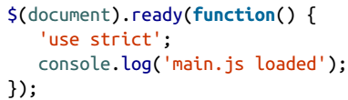
jQuery in Action
Now we’ll modify our main.js file to take advantage of one of jQuery’s features:
Unless you’ve already had some experience with jQuery, this probably looks like gibberish.
There’s actually a lot going on here that won’t become clear until much later.
What jQuery is doing for us here is making sure that the browser has loaded all of the HTML before executing our JavaScript (which is currently just a single console.log).
Whenever we’re working with browser-based JavaScript, we’ll be doing this just to establish the practice: any JavaScript you write will go between the $(document).ready(function() { and }); lines.
Also note the line 'use strict'; this is something we’ll learn more about later, but basically this tells the JavaScript interpreter to treat your code more rigorously.
While that may not sound like a good thing at first, it actually helps you write better JavaScript, and prevents common and difficult-to-diagnose problems.
We’ll certainly be learning to write very rigorous JavaScript in this book!

Slide 29
Drawing Graphics Primitive
Among many of the benefits HTML5 brought was a standardized graphics interface.
The HTML5 canvas allows you to draw graphics primitives like
Squares
Circles
Polygons
Using the canvas directly can be painful, so we’ll use a graphics library called Paper.js to take advantage of the HTML5 canvas.
Before we start using Paper.js to draw things, we’ll need an HTML canvas element to draw on.
Add the following to the body (you can put it anywhere; after the intro paragraph, for example):
Note that we’ve given the canvas an id attribute: that’s how we will be able to easily refer to it from within JavaScript and CSS.
If we load our page right now, we won’t see anything different; not only haven’t we drawn anything on the canvas, but it’s a white canvas on a white page and has no width and height, making it very hard to see indeed.

Slide 30
NOTE
Paper.js is not the only canvas graphics library available:
KineticJS
Fabric.js
EaselJS
are very popular and robust alternatives.
I’ve used all of these libraries, and they’re all very high quality.
Every HTML element can have an ID, and for the HTML to be valid (correctly formed), each ID must be unique.
So now that we’ve created a canvas with the id “mainCanvas”, we can’t reuse that ID.
Because of this, it’s recommended that you use IDs sparingly.
We’re using one here because it’s often easier for beginners to deal with one thing at a time, and by definition, an ID can only refer to one thing on a page.

Slide 31
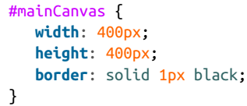
CSS
Let’s modify main.css so our canvas stands out on the page.
If you’re not familiar with CSS, that’s OK—this CSS is simply setting a width and height for our HTML element, and giving it a black border:
If you reload your page, you should see the canvas now.

Slide 32
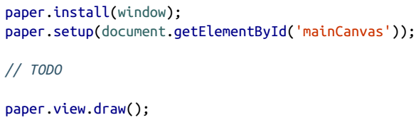
Paper.js
Right after we link in jQuery, but before we link in our own main.js, add the following line:
Note that, as with jQuery, we’re using a CDN to include Paper.js in our project.
Now that we have Paper.js linked in, we have to do a little work to configure Paper.js.
Whenever you encounter code like this—repetitive code that is required before you do something—it’s often called boilerplate.
Add the following to main.js, right after 'use strict' (you can remove the console.log if you wish):

Slide 33

Paper.js |
The first line installs Paper.js in the global scope (which will make more sense in Chapter 7).
The second line attaches Paper.js to the canvas, and prepares Paper.js for drawing.
In the middle, where we put TODO is where we’ll actually be doing the interesting stuff.
The last line tells Paper.js to actually draw something to the screen.
Now that all of the boilerplate is out of the way, let’s draw something!
We’ll start with a green circle in the middle of the canvas.
Replace the “TODO” comment with the following lines:
Refresh your browser, and behold, a green circle.
You’ve written your first real JavaScript.
There’s actually a lot going on in those two lines, but for now, it’s only important to know a few things.
The first line creates a circle object, and it does so with three arguments: the x and y coordinates of the center of the circle, and the radius of the circle.

Slide 34
Paper.js |
Recall we made our canvas 400 pixels wide and 400 pixels tall, so the center of the canvas lies at (200, 200).
And a radius of 50 makes a circle that’s an eighth of the width and height of the canvas.
The second line sets the fill color, which is distinct from the outline color (called the stroke in Paper.js parlance). Feel free to experiment with changing those arguments.

Slide 35
NOTE
You might be starting to realize that the order in which we link things in is very important.
We’re going to use both jQuery and Paper.js in our own main.js, so we have to link in both of those first.
Neither of them depends on the other, so it doesn’t matter which one comes first, but I always include jQuery first as a matter of habit, as so many things in web development depend on it.

Slide 36
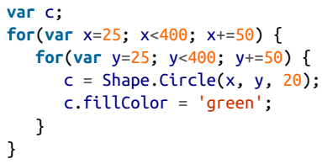
Automating Repetitive Tasks
Consider what you’d have to do if you wanted not just to add one circle, but to fill the canvas with them, laid out in a grid.
If you space the circles 50 pixels apart and make them slightly smaller, you could fit 64 of them on the canvas.
Certainly you could copy the code you’ve already written 63 times, and by hand, modify all of the coordinates so that they’re spaced out in a grid.
Sounds like a lot of work, doesn’t it?
Fortunately, this kind of repetitive task is what computers excel at.
Let’s see how we can draw out 64 circles, evenly spaced.
We’ll replace our code that draws a single circle with the following:

Slide 37
Automating Repetitive Tasks |
If you refresh your browser, you’ll see we have 64 green circles!
If you’re new to programming, what you’ve just written may seem confusing, but you can see it’s better than writing the 128 lines it would take to do this by hand.
What we’ve used is called a for loop, which is part of the control flow syntax that we’ll learn about in detail in Chapter 4.
A for loop allows you to specify an initial condition (25), an ending condition (less than 400), and an increment value (50).
We use one loop inside the other to accomplish this for both the x-axis and y-axis.

Slide 38
NOTE
There are many ways we could have written this example.
The way we’ve written it, we’ve made the x and y coordinates the important pieces of information:
we explicitly specify where the circles will start and how far apart they’ll be spaced.
We could have approached this problem from another direction:
we could have said what’s important is the number of circles we want (64), and let the program figure out how to space them so that they fit on the canvas.
The reason we went with this solution is that it better matches what we would have done if we had cut and pasted our circle code 64 times and figured out the spacing ourselves.

Slide 39
Handling User Input
So far, what we’ve been doing hasn’t had any input from the user.
The user can click on the circles, but it doesn’t do anything.
Likewise, trying to drag a circle would have no effect.
Let’s make this a little more interactive, by allowing the user to choose where the circles get drawn.
It’s important to become comfortable with the asynchronous nature of user input.
An asynchronous event is an event whose timing you don’t have any control over.
A user’s mouse click is an example of an asynchronous event: you can’t be inside your users’ minds, knowing when they’re going to click.
Certainly you can prompt their click response, but it is up to them when—and if—they actually click.
Asynchronous events arising from user input make intuitive sense, but we will cover much less intuitive asynchronous events in later chapters.
Paper.js uses an object called a tool to handle user input.
If that choice of names seems unintuitive to you, you are in good company: I agree, and don’t know why the Paper.js developers used that terminology.
It might help you to translate “tool” to “user input tool” in your mind.

Slide 40
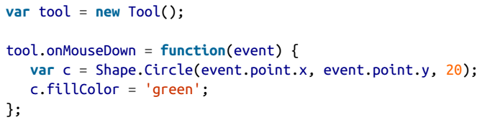
Tool object
Let’s replace our code that drew a grid of circles with the following code:
The first step in this code is to create our tool object.
Once we’ve done that, we can attach an event handler to it.
In this case, the event handler is called onMouseDown.
Whenever the user clicks the mouse, the function we’ve attached to this handler is invoked.
This is a very important point to understand.
In our previous code, the code ran right away: we refreshed the browser, and the green circles appeared automatically.
That is not happening here: if it were, it would draw a single green circle somewhere on the screen.
Instead, the code contained between the curly braces after function is executed only when the user clicks the mouse on the canvas.

Slide 41
Tool object |
The event handler is doing two things for you:
it is executing your code when the mouse is clicked
it is telling you where the mouse was clicked
That location is stored in a property of the argument, event.point, which has two properties, x and y, indicating where the mouse was clicked.
Note that we could save ourselves a little typing by passing the point directly to the circle (instead of passing the x and y coordinates separately):
This highlights a very important aspect of JavaScript: it’s able to ascertain information about the variables that are passed in.
In the previous case, if it sees three numbers in a row, it knows that they represent the x and y coordinates and the radius.
If it sees two arguments, it knows that the first one is a point object, and the second one is the radius.
We’ll learn more about this in Chapters 6 and 9.

Slide 42
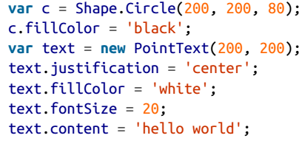
Hello, World
Let’s conclude this chapter with a manifestation of Brian Kernighan’s 1972 example.
We’ve already done all the heavy lifting: all that remains is to add the text.
Before your onMouseDown handler, add the following:
This addition is fairly straightforward: we create another circle, which will be a backdrop for our text, and then we actually create the text object (PointText).
We specify where to draw it (the center of the screen) and some additional properties (justification, color, and size).
Lastly, we specify the actual text contents (“hello world”).
Note that this is not the first time we emitted text with JavaScript: we did that first with console.log earlier in this chapter.

Slide 43
Hello, World |
We certainly could have changed that text to “hello world.”
In many ways, that would be more analogous to the experience you would have had in 1972, but the point of the example is not the text or how it’s rendered: the point is that you’re creating something autonomous, which has observable effects.
By refreshing your browser with this code, you are participating in a venerable tradition of “Hello, World” examples.
If this is your first “Hello, World,” let me welcome you to the club.
If it is not, I hope that this example has given you some insight into JavaScript.

Slide 44
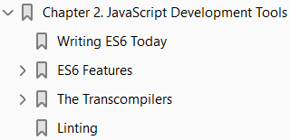
2
JavaScript Development Tools

Slide 45
Intro
While you can write JavaScript with nothing more than an editor and a browser (as we saw in the previous chapter), JavaScript developers rely on some useful development tools.
Furthermore, because we are focusing on ES6 for the rest of this book, we’ll need a way to convert our ES6 code to portable ES5 code.
The tools discussed in this chapter are very common, and you are likely to encounter them in any open source project or software development team.

Slide 46
Tools
The list of tools required are:
Git, a version control tool that helps you manage your project as it grows, and collaborate with other developers.
Node, which allows you to run JavaScript outside of the browser (and comes with npm, which gives you access to the rest of the tools on this list).
Gulp, a build tool that automates common development tasks (Grunt is a popular alternative).
Babel, a transcompiler that converts ES6 code to portable ES5 code.
ESLint, a linter that helps you avoid common mistakes and makes you a better programmer!
Don’t think of this chapter as a distraction from the topic at hand (JavaScript).
Think of it as a practical introduction to some important tools and techniques that are commonly used in JavaScript development.

Slide 47
Writing ES6 Today
I have good news and bad news.
The good news is that ES6 (aka Harmony, aka JavaScript 2015) is an exciting, delightful evolution in the history of JavaScript.
The bad news is that the world isn’t quite ready for it.
That doesn’t mean you can’t use it now, but it is going to put an extra burden on the programmer, as ES6 code has to be transcompiled into “safe” ES5 to ensure that it can run anywhere.
Programmers who have been around a while might be thinking “big deal; back in my day, there was no such thing as a language that didn’t have to be compiled and linked!”
I’ve been writing software long enough to remember that time, but I do not miss it: I enjoy the lack of fuss in interpreted languages like JavaScript.
One of the advantages of JavaScript has always been its ubiquity: it became the standard browser scripting language almost overnight, and with the advent of Node, its use broadened beyond the browser.
So it is a bit painful to recognize that it will probably be a few years before you can ship ES6 code without worrying about browsers that don’t support it.
If you’re a Node developer, the situation is a little bit brighter: because you only have one JavaScript engine to worry about, you can track the progress of ES6 support in Node.

Slide 48
NOTE
The ES6 examples in this book can be run in Firefox, or on a website such as ES6 Fiddle.
For “real-world code,” however, you will want to know the tools and techniques in this chapter.

Slide 49
ES5 to ES6
One interesting aspect about JavaScript’s transition from ES5 to ES6 is that, unlike language releases of the past, the adoption is gradual.
That is, the browser you’re using right now probably has some—but not all—features available in ES6.
This gradual transition is made possible in part by the dynamic nature of JavaScript, and in part by the changing nature of browser updates.
You may have heard the term evergreen used to describe browsers: browser manufacturers are moving away from the concept of having discrete browser versions that have to be updated.
Browsers, they reason, should be able to keep themselves up to date because they are always connected to the Internet (at least if they are going to be useful).
Browsers still have versions, but it is now more reasonable to assume that your users have the latest version—because evergreen browsers don’t give users the option not to upgrade.
Even with evergreen browsers, however, it will be a while before you can rely on all of the great features of ES6 being available on the client side.
So for the time being, transcompilation (also called transpilation) is a fact of life.

Slide 50
ES6 Features
There are a lot of new features in ES6—so many that even the transcompilers we’ll be talking about don’t currently support all of them.
To help control the chaos, New York–based developer kangax maintains an excellent compatibility table of ES6 (and ES7) features.
As of August 2015, the most complete implementation (Babel) is only at 72%.
While that may sound discouraging, it’s the most important features that have been implemented first, and all of the features discussed in this book are available in Babel.
We have a little bit of prep work to do before we can start transcompiling.
We’ll need to make sure we have the necessary tools, and learn how to set up a new project to use them—a process that will become automatic after you do it a few times.
In the meantime, you will probably want to refer back to this chapter as you start new projects.

Slide 51
Installing Git
If you don’t have Git installed on your system, you can find downloads and instructions for your operating system on the Git home page.

Slide 52
The Terminal
Throughout this chapter, we’ll be working in the terminal (also known as the command line or command prompt).
The terminal is a text-based way of interacting with your computer, and is commonly used by programmers.
Though it is certainly possible to be an effective programmer without ever using the terminal, I believe it is an important skill to have: many tutorials and books assume you’re using a terminal, and many tools are designed to be used on the terminal.
The most ubiquitous terminal experience is a shell (terminal interface) called bash, and it is available by default on Linux and OS X machines.
While Windows has its own command-line experience, Git (which we will install next) provides a bash command line, which I recommend you use.
In this book, we will be using bash.
On Linux and OS X, look in your programs for the Terminal program.
On Windows, after you install Git, look for “Git Bash” in your programs.
When you start the terminal, you see a prompt, which is where you will type commands.
The default prompt may include the name of your computer or the directory you’re in, and it will normally end with a dollar sign ($).

Slide 53

The Terminal |
Thus, in the code samples in this chapter, I will use a dollar sign to indicate the prompt.
What follows the prompt is what you should type.
For example, to get a listing of the files in the current directory, type ls at the prompt:
In Unix, and therefore bash, directory names are separated with a forward slash (/).
Even in Windows, where directories are normally separated by backslashes (\), Git Bash translates backslashes to forward slashes.
Bash also uses the tilde (~) as a shortcut for your home directory (where you should normally be storing your files).

Slide 54
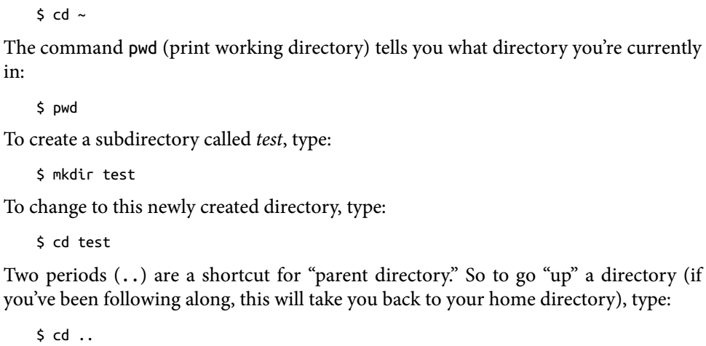
Example
The basics you’ll need are the ability to change the current directory (cd), and make new directories (mkdir).
For example, to go to your home directory, type:
There’s a lot more to learn about the terminal, but these basic commands are all you need to get through the material in this chapter.
If you want to learn more, I recommend the Console Foundations course on Treehouse.

Slide 55
Your Project Root
You’ll want to create a directory for each project.
We’ll call this directory the project root.
For example, if you’re following along with the examples in this book, you could create an lj directory, which would be your project root.
In all the command-line examples in this book, we’ll assume that you’re in the project root.
If you try an example and it doesn’t work, the first thing to verify is that you’re in the project root.
Any files we create will be relative to the project root.
For example, if your project root is /home/joe/work/lj, and we ask you to create a file public/js/test.js, the full path to that file should be
/home/joe/work/lj/public/js/test.js

Slide 56
Version Control: Git
We won’t discuss version control in detail in this book, but if you’re not using it, you should be.
If you’re not familiar with Git, I encourage you to use this book as an opportunity to practice.
First, from your project root, initialize a repository:

Slide 58
The Transcompilers
As I write this, the two most popular transcompilers are
Babel
Traceur
I have used both, and they are both quite capable and easy to use. I am currently leaning slightly toward Babel, and we’ll be using it as the transcompiler in this book. So let’s get started! Babel started as a ES5 to ES6 transcompiler, and has grown to be a general-purpose transcompiler that’s capable of many different transformations, including ES6, React, and even ES7. Starting with version 6 of Babel, transformations are no longer included with Babel. To perform our ES5 to ES6 transformation, we need to install the ES6 transformations and configure Babel to use them. We make these settings local to our project, as it is conceivable that we’ll want to use ES6 on one project, React on another, and ES7 (or some other variant) on another. First, we install the ES6 (aka ES2015) preset:
(Page 25).

Slide 59
Running Babel with Gulp
Now we can use Gulp to do something actually useful: convert the ES6 code we’ll be writing to portable ES5 code. We’ll convert any code in es6 and public/es6 to ES5 code in dist and public/dist. We’ll be using a package called gulp-babel, so we start by installing it with npm install --save-dev gulp-babel. Then we edit gulpfile.js:
(Page 25).

Slide 60
Linting
Do you run a lint roller over your dress or suit before you go to a fancy party or an interview? Of course you do: you want to look your best. Likewise, you can lint your code to make it (and by extension, you) look its best. A linter takes a critical eye to your code and lets you know when you’re making common mistakes. I’ve been writ‐ ing software for 25 years, and a good linter will still find mistakes in my code before I do. For the beginner, it’s an invaluable tool that can save you a lot of frustration. There are several JavaScript linters out there, but my preference is Nicholas Zakas’s ESLint. Install ESLint:
(Page 27).

Slide 61
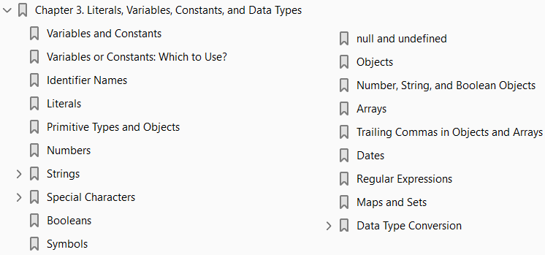
3
Literals, Variables, Constants, and Data Types

Slide 62
Intro
This chapter is about data, and how we translate data into a format that JavaScript can understand.
You’re probably aware that all data is ultimately represented inside a computer as long sequences of ones and zeros—but for most day-to-day tasks, we want to think about data in a way that’s more natural to us:
Numbers
Text
dates, and so on
We will call these abstractions data types.
Before we dive into the data types available in JavaScript, we will discuss
Variables
Constants
Literals
which are the mechanisms available to us in JavaScript for holding data

Slide 63
NOTE
The importance of vocabulary is often overlooked when you’re learning to program.
While it may not seem important to understand how a literal differs from a value, or a statement from an expression, not knowing these terms will hamper your ability to learn.
Most of these terms are not specific to JavaScript, but are commonly understood in computer science.
Having a good grasp of the concepts is important, of course, but paying attention to vocabulary makes it easy for you to transfer your knowledge to other languages, and learn from more sources.

Slide 80
Regular Expressions
A regular expression (or regex or regexp) is something of a sublanguage of JavaScript.
It is a common language extension offered by many different programming languages, and it represents a compact way to perform complex search and replace operations on strings. Regular expressions will be covered in Chapter 17. Regular expressions in JavaScript are represented by the RegExp object, and they have a literal syntax consisting of symbols between a pair of forward slashes. Here are some examples (which will look like gibberish if you’ve never seen a regex before):
(Page 51).

Slide 81
Maps and Sets
ES6 introduces the data types Map and Set, and their “weak” counterparts, WeakMap and WeakSet.
Maps, like objects, map keys to values, but offer some advantages over objects in certain situations.
Sets are similar to arrays, except they can’t contain duplicates.
The weak counterparts function similarly, but they make functionality tradeoffs in exchange for more performance in certain situations.
We will cover maps and sets in Chapter 10.

Slide 83
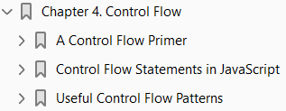
4

Slide 84
Intro

Slide 85
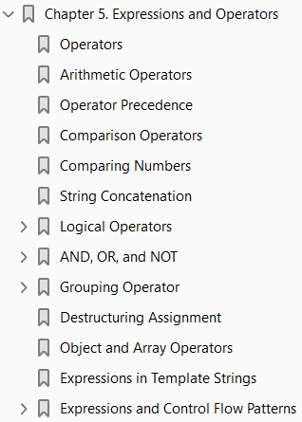
5

Slide 86
Intro

Slide 87
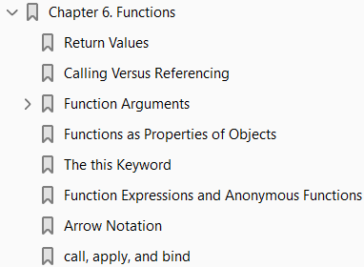
6

Slide 88
Intro

Slide 89
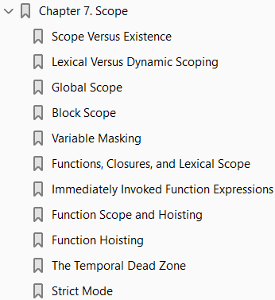
7

Slide 90
Intro

Slide 91
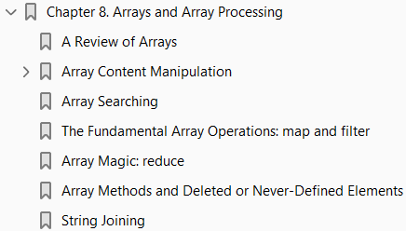
8

Slide 92
Intro

Slide 93
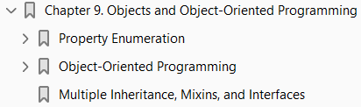
9

Slide 94
Intro

Slide 95
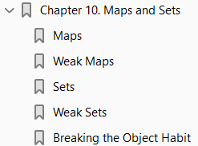
10
Maps and Sets

Slide 96
Intro
ES6 introduces two welcome data structures:
Maps
Sets
Maps are similar to objects in that they can map a key to a value, and sets are similar to arrays except that duplicates are not allowed.

Slide 97
Maps
Prior to ES6, when you needed to map keys to values, you would turn to an object, because objects allow you to map string keys to object values of any type.
However, using objects for this purpose has many drawbacks:
The prototypal nature of objects means that there could be mappings that you didn’t intend.
There’s no easy way to know how many mappings there are in an object.
Keys must be strings or symbols, preventing you from mapping objects to values.
Objects do not guarantee any order to their properties.
The Map object addresses these deficiencies, and is a superior choice for mapping keys to values (even if the keys are strings).

Slide 98
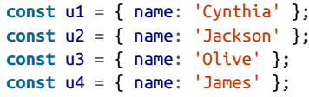
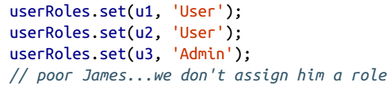
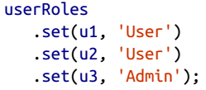
Example
For example, imagine you have user objects you wish to map to roles:
You would start by creating a map:
Then you can use the map to assign users to roles by using its set( ) method:
The set( ) method is also chainable, which can save some typing:

Slide 103
11
Exceptions and Error Handling

Slide 104
Intro
As much as we would all like to live in an error-free world, we don’t have that luxury.
Even the most trivial applications are subject to errors arising from conditions you didn’t anticipate.
The first step to writing robust, high-quality software is acknowledging that it will have errors.
The second step is anticipating those errors and handling them in a reasonable fashion.
Exception handling is a mechanism that came about to deal with errors in a controlled fashion.
It’s called exception handling (as opposed to error handling) because it’s meant to deal with exceptional circumstances—that is, not the errors you anticipate, but the ones you don’t.
The line between anticipated errors and unanticipated errors (exceptions) is a blurry one that is very much situational.
An application that is designed to be used by the general, untrained public may anticipate a lot more unpredictable behavior than an application designed to be used by trained users.
An example of an anticipated error is someone providing an invalid email address on a form:
people make typos all the time.
An unanticipated error might be running out of disk space, or a usually reliable service being unavailable.

Slide 105
The Error Object
JavaScript has a built-in Error object, which is convenient for any kind of error handling (exceptional or anticipated).
When you create an instance of Error, you can provide an error message:
Creating an Error instance doesn’t, by itself, do anything.
What it does is give you something that can be used to communicate errors. Imagine a function that validates

